Slide 1
⚓
AutoChart
UK Hydrographic Office · Geospatial Chart Comparison Platform
NILESH WAIRAGADE (UKHO)
SAKIRAT USMAN (NHSBSA)
+
UKHO - AutoChart Team
Project retrospective — what was built, how, and why
2026

Slide 2
01 The Problem
Navigation Chart Lifecycle
AutoChart — The Solution
◆ Mariners / Fishermen need to know which new chart replaces their old one — and where coverage overlaps
✓ Instant chart lookup by number, name, title, or panel ID
✓ Interactive Leaflet map showing old & new polygons + intersection
◆ Previously: manual and time-consuming comparison with no tool available.
✓ Natural-language chatbot that answers "what replaces chart 5011?"
◆ No self-service tool existed for customers or analysts
✓ MCP / Agent interface for AI-assisted querying
✓ REST API + GeoJSON export for downstream tools
◆ Scale mismatches and partial overlaps were especially hard to reason about
✓ WCAG 2.2 Compliant
AutoChart · UKHO · 2026
2 / 10

Slide 3
02 Architecture
Single-process design (ADR 0001) — one container, three interfaces
FastAPI (Python 3.13)
Browser
(React SPA)
GeoJSON
Shapefiles
GeoPandas
DataFrames
(LRU cached)
HTTP / WS
REST Routes /api/*
routes.py — 8 typed endpoints
MCP Server /mcp
JSON-RPC 2.0 — 7 tools
Service Layer
data.py • overlap.py
AI Agent
(MCP client)
Security Middleware
API-key gate • CORS • X-Request-ID
Sentry
OTEL Collector
Prometheus
Static SPA Mount /
Serves built React bundle
Observability
Prometheus • OTEL • Sentry
AutoChart · UKHO · 2026
3 / 10

Slide 4
03 Tech Stack
Backend
Frontend
Infra & Tooling
▸ Python 3.13 (UV-managed deps)
▸ React 18.3 + Vite 5
▸ Docker multi-stage (Node 22 → Py 3.13)
▸ FastAPI 0.116 + Uvicorn
▸ Leaflet 1.9 + react-leaflet 4.2
▸ docker-compose — single service
▸ GeoPandas 1.1.4 + Shapely
▸ web-vitals 4.2 (CLS/INP/LCP…)
▸ GitHub Actions CI (ubuntu-24.04)
▸ Matplotlib 3.11 (headless Agg)
▸ ESLint 9 + Prettier 3.9
▸ Ruff — lint + format (Python)
▸ Pydantic — schema & validation
▸ Vitest 2.1 + React Testing Library
▸ mypy — type checking
▸ structlog — structured logging
▸ Playwright 1.62 (E2E)
▸ pre-commit — local gate
AutoChart · UKHO · 2026
4 / 10

Slide 5
04 Core Features
💬 Natural-Language Chatbot
🗺 Interactive Map View
🤖 MCP Agent Interface
POST /api/chat — infers chart_number / chart_name / panel_id from free text and returns human-readable prose via chart.answer()
Leaflet SPA shows old panels (navy), new panels (teal), and intersection polygons (gold). Fetches /api/overlap-geojson on each lookup.
JSON-RPC 2.0 at /mcp — 7 tools (chart.lookup, chart.answer, chart.overlap, chart.compare, chart.overlap_geojson, chart.list_panels, chart.get_data).
📊 Overlap Metrics & PNG
🔍 Multi-Mode Chart Lookup
📡 GeoJSON REST API
POST /api/overlap returns base64 matplotlib PNG + overlap area %. Geometry computed in EPSG:27700 (metric BNG), returned in EPSG:4326.
Four modes: chart_number (digit extract), chart_name/chart_title (case-insensitive substring), panel_id (exact). Covers old & new datasets simultaneously.
GET /api/data, /api/panels, POST /api/overlap-geojson — programmatic access to chart geometry and intersection data with max_scale filtering.
AutoChart · UKHO · 2026
5 / 10

Slide 6
05 Security
🔒 API Key Middleware
🔒 CORS Policy
Optional API-key gating protects REST and MCP endpoints.
Configurable allowed origins restrict browser access.
🔒 Docker Hardening
🔒 Browser & SPA Safety
Non-root runtime, read-only filesystem and tmpfs for /tmp.
FastAPI serves the SPA with same-origin and CORS controls.
🔒 Request Integrity
🔒 Pre-commit Gates
X-Request-ID enables consistent request correlation.
Ruff, mypy and formatting checks run before each commit.
AutoChart · UKHO · 2026
6 / 10

Slide 7
06 Observability (ADR 0003)
Three narrowly-scoped libraries — env-gated — zero cost when unconfigured
📈 Prometheus
🔭 OpenTelemetry
🚨 Sentry
AUTOCHART_METRICS=1
OTEL_EXPORTER_OTLP_ENDPOINT
SENTRY_DSN
⚡ Web Vitals
🟢 Health Probes
📋 Structured Logging
POST /api/telemetry
/livez & /healthz
AUTOCHART_LOG_JSON=1
AutoChart · UKHO · 2026
7 / 10

Slide 8
07 CI/CD & Testing
Backend
(Python 3.13)
Frontend
(Node 22)
Docker
Build
✓ Ruff lint + format
✓ ESLint 9
✓ Multi-stage build
→
→
✓ mypy type check
✓ Prettier check
✓ GHA layer cache
✓ pytest + coverage
✓ Vitest (60% cov)
✓ Tagged autochart:ci
✓ 75% threshold
✓ Vite build
✓ Blocked on prev. jobs
Test Coverage Matrix
Backend
pytest
test_data, test_api, test_mcp, test_security, test_overlap, test_observability
75% overall
Frontend
Vitest + RTL
ChatBot, MapView, MCPChat components
60% lines / 55% functions
E2E
Playwright
chatbot.spec.js — home, agent chatbot, REST + MCP health
Chrome Desktop
AutoChart · UKHO · 2026
8 / 10

Slide 9
08 Deployment
Multi-Stage Dockerfile
docker-compose.yml
Stage 1: Node 22-alpine
▸ image: autochart:local
• npm ci + npm run build
▸ ports: 8000:8000
• Outputs /frontend/dist
▸ read_only: true
Stage 2: Python 3.13-slim
▸ tmpfs: /tmp (writable ephemeral zone)
• Install libexpat1 + curl (runtime only)
▸ restart: unless-stopped
• Create non-root user 'app'
▸ healthcheck: curl -fsS /api/health
• UV installs Python deps (prod-only, no dev)
▸ AUTOCHART_HOST: 0.0.0.0
• COPY --from=web /frontend/dist
• Port 8000 • CMD: uv run uvicorn
▸ AUTOCHART_ALLOWED_ORIGINS: configurable
Key Environment Variables
AUTOCHART_API_KEY
(unset)
Enables /api and /mcp key-gating
OTEL_EXPORTER_OTLP_ENDPOINT
(unset)
OpenTelemetry collector URL
AUTOCHART_LOG_JSON
1
JSON vs console log output
SENTRY_DSN
(unset)
Sentry error reporting
AUTOCHART_METRICS
1
Expose Prometheus /metrics
SENTRY_TRACES_SAMPLE_RATE
0.0
Trace sampling (0–1)
AutoChart · UKHO · 2026
9 / 10

Slide 10
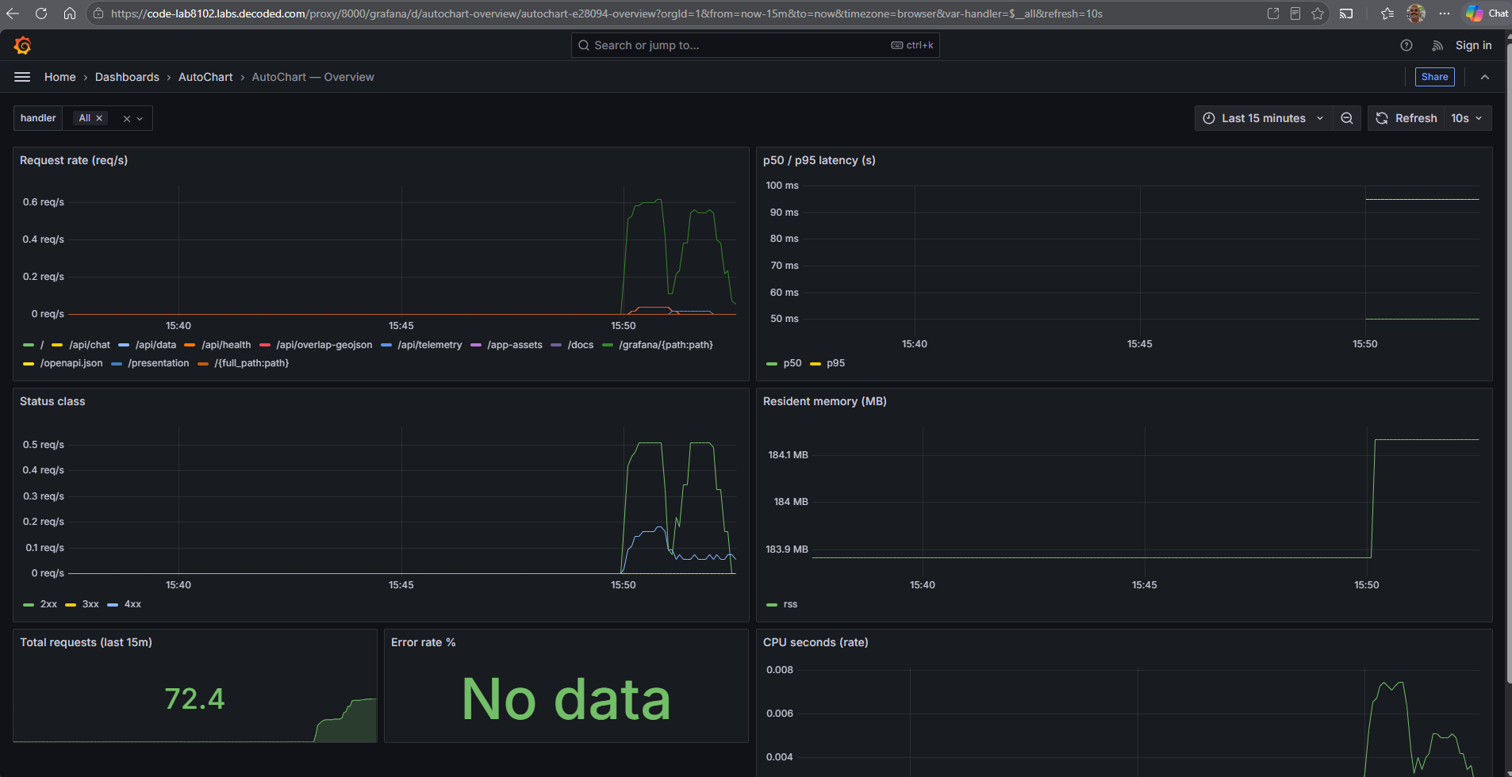
09 Observability
AutoChart · UKHO · 2026
9 / 10

Slide 11
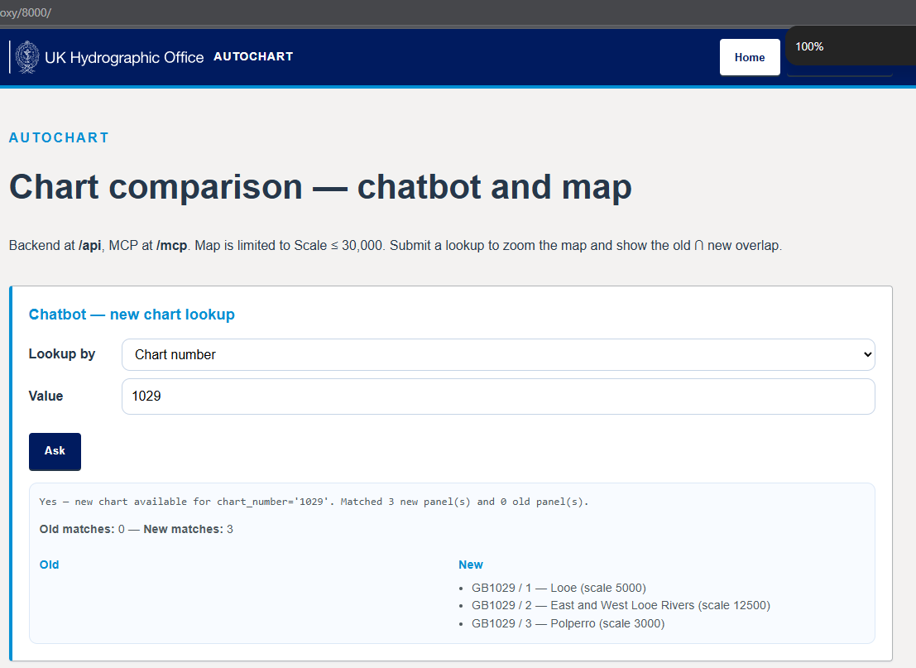
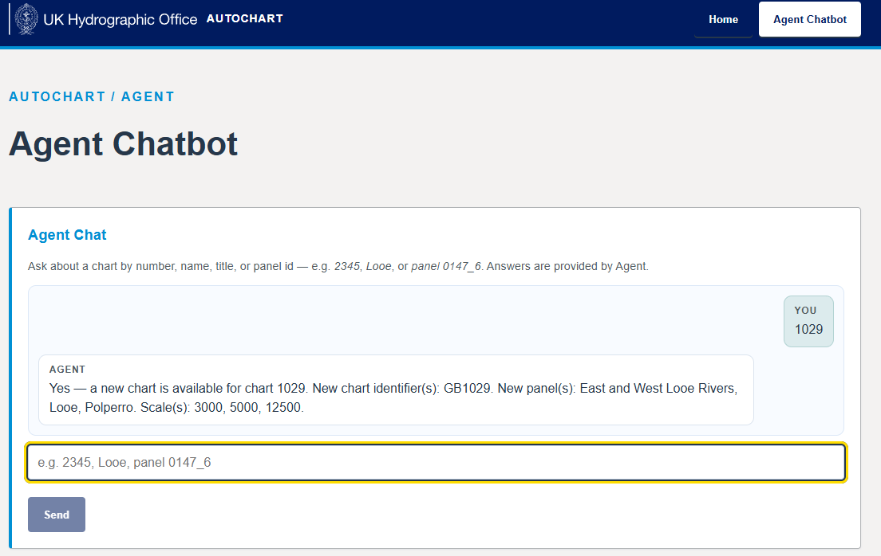
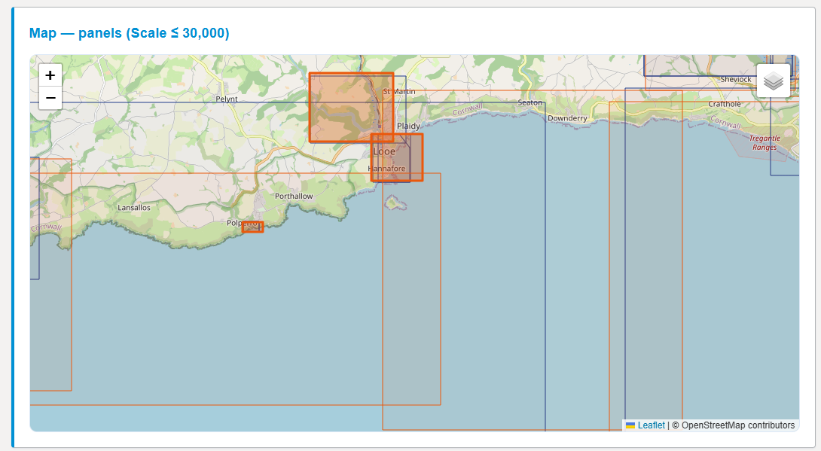
09 App Page
AutoChart · UKHO · 2026
9 / 10

Slide 12
What Was Built
🗺️ Map + Chatbot
🤖 MCP Agent
🔒 Secure by default
Interactive Leaflet map + NL chatbot
7-tool JSON-RPC 2.0 AI interface
API key, CORS, Docker hardening
📈 Full observability
✅ CI/CD pipeline
📦 One container
Prometheus · OTEL · Sentry · Web Vitals
Lint · Type · Test · Build · Docker
FastAPI serves SPA + REST + MCP
AutoChart — from manual shapefile comparison to a full-stack,
observability-ready geospatial platform.
Repository: github.com/iNileshW/AutoChart
10 / 10

